Slide 1

Unit 02.03.03
CS 5220:
COMPUTER COMMUNICATIONS
Random Access: CSMA & CSMA-CD
XIAOBO ZHOU, Ph.D.
Professor, Department of Computer Science

Slide 2
CSMA
Carrier Sensing Multiple Access (CSMA)
  When collisions occur they involve entire frame transmission time
  Sensing for detecting an ongoing transmission
  Avoids transmission certain to cause collisions

Slide 3
Carrier Sensing Multiple Access (CSMA)
A station senses the channel before it starts transmission
  If busy, either wait or schedule backoff (different options)
  If idle, start transmission
  Vulnerable period is reduced to t_{prop} (due to channel capture effect)
Station A begins transmission at t = 0
A
Station A captures
channel at t = t_{prop}
A

Slide 4
CSMA Options: 1-persistent CSMA
Transmitter behavior when busy channel is sensed
  1-persistent CSMA (most greedy)
    Start transmission as soon as the channel becomes idle
    Low delay and low efficiency

Slide 5
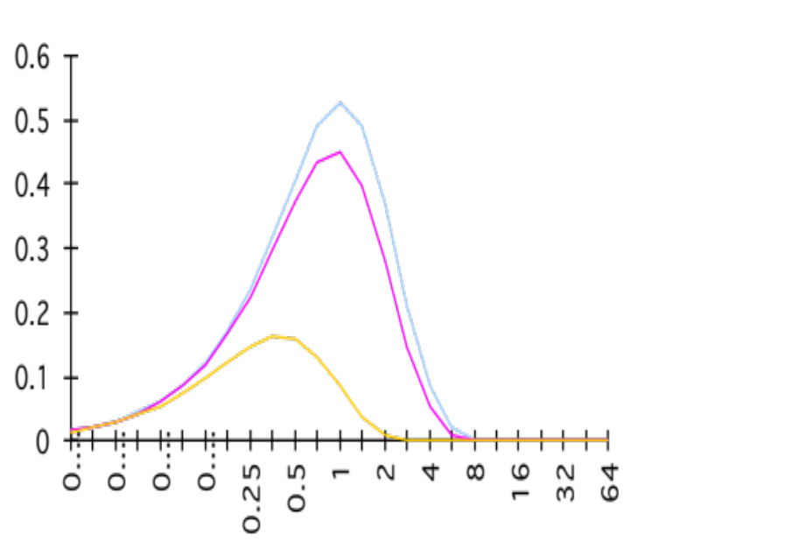
1-Persistent CSMA Throughput
S
0.53
Normalized propagation delay a (t_{prog}/X)
Better than Aloha & slotted Aloha for small a
Worse than Aloha for a > 1
a = 0.01
0.45
0.16
a =0.1
G
a = 1

Slide 6
CSMA Options
  Non-persistent CSMA (least greedy)
    If busy, wait a backoff period, then sense carrier again
    High delay and high efficiency
  p-persistent CSMA (adjustable greedy)
    Wait till channel becomes idle, transmit with probability p; or wait one t_{prop} & re-sense with probability 1-p
    Delay and efficiency can be balanced
Sensing

Slide 7
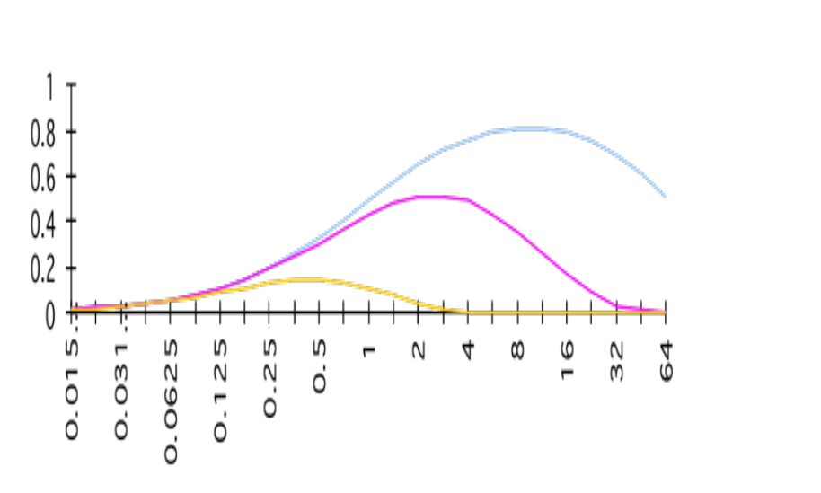
Non-Persistent CSMA Throughput
S
a = 0.01
Higher maximum throughput than 1-persistent for small a
Worse than Aloha for a > 1
0.81
0.51
a = 0.1
0.14
a = 1
G

Slide 8
CSMA with Collision Detection (CSMA/CD)
Monitor for collisions & abort transmission
  Stations with frames to send, first do carrier sensing
  After beginning transmissions, stations continue listening to the medium to detect collisions
  If collisions detected, all stations involved abort transmission, reschedule random backoff times, and try again at scheduled times - quickly terminating a damaged frame saves time & bandwidth (T_trans >> T_prog)
  In CSMA, collisions result in wastage of entire frame transmission time
  CSMA-CD reduces wastage to time to detect collision & abort transmission

Slide 9
CSMA/CD reaction time
A begins to
transmit at
t = 0
A
B
B begins to
transmit at
t = t_{prop}- δ;
B detects
collision at
t = t_{prop}
A
B
A detects
collision at
t= 2 t_{prop}- δ
A
B
It takes 2 t_{prop} to find out if channel has been captured

Slide 10
CSMA-CD Model
  Collisions can be detected and resolved in 2t_{prop}
  Time slotted in 2t_{prop} slots during contention periods
  Once the contention period is over (a station successfully occupies the channel), it takes X seconds for a frame to be transmitted
  It takes t_{prop} before the next contention period starts.
Busy
Contention
Busy
Idle
Contention
Busy
Time

Slide 11
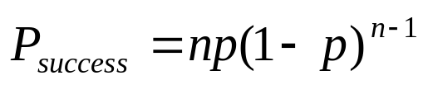
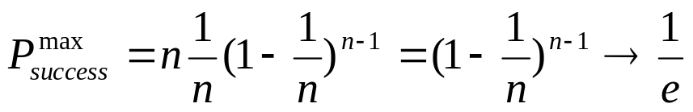
Contention Resolution
Contention is resolved if exactly 1 station transmits in a slot
  Assume n busy stations, and each may transmit with probability p in each contention time slot
  By taking derivative of P_{success} we find max occurs at p=1/n
  On average, 1/P^{max} = e = 2.718 time slots to resolve contention

Slide 12
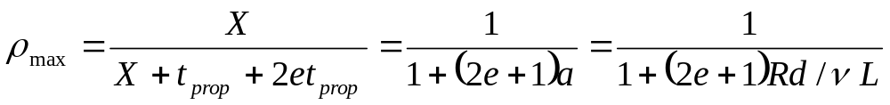
CSMA/CD Throughput
At maximum throughput, systems alternates between contention periods and frame transmission times
where:
  R bits/sec, L bits/frame, X=L/R seconds/frame
  a = t_{prop}/X (normalized propagation delay)
  ν meters/sec.
  d meters is diameter of system
  2e+1 = 6.44

Slide 13
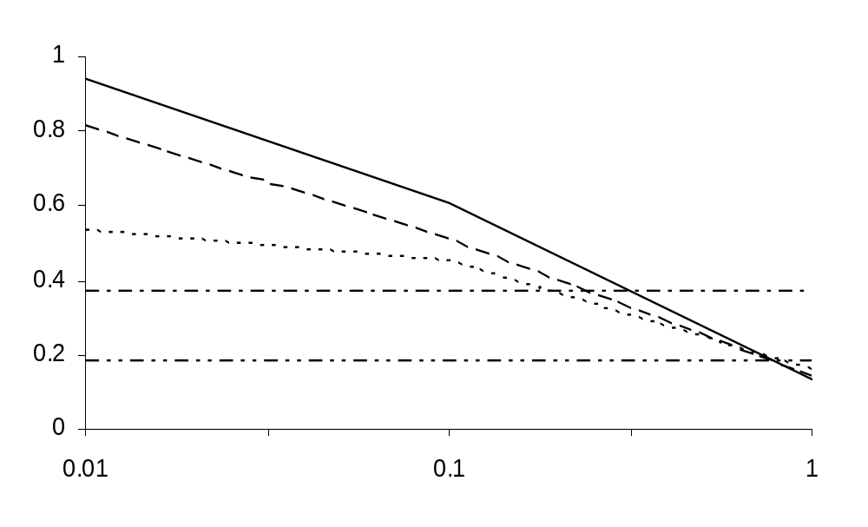
Summary: Throughput for Random Access MACs
CSMA/CD
1-P CSMA
Non-P CSMA
ρ_{max}
Slotted ALOHA
ALOHA
a
For small a: CSMA-CD has best maximum throughput
For larger a: Aloha & slotted Aloha better maximum throughput, since not dependent on a (normalized propagation delay)

